Slide 1
Unseen Consequences
Frederic Bastiat and his Continuing Relevance to Public Policy Debates

Slide 2
Economic Policy Debates and the Role of Think Tanks
Many policy debates in DC center on economics
Legislators and their staffs only have limited expertise
Think tanks advance arguments with more specialized knowledge
But often these arguments are based on economic principles
Concepts like transaction costs need to be explained again and again…
Which is why we should study Frederic Bastiat

Slide 3
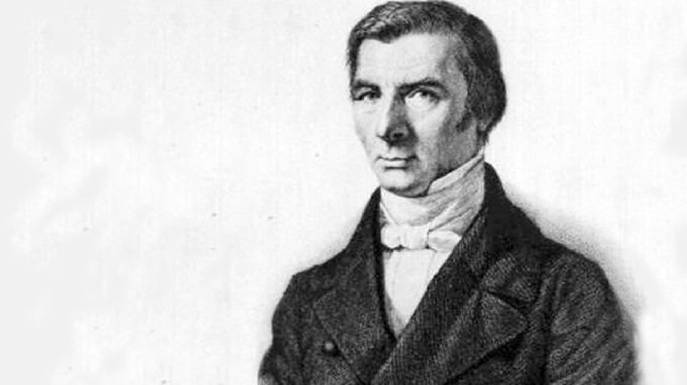
Frederic Bastiat (1801-1850)
An economic journalist, not an economist
Issued pamphlets rather than books
Challenged “economic sophisms”
An early opponent of socialism
Petition of the Candlemakers
That Which is Seen and that Which is Not
La Loi

Slide 4
Petition of the Candlemakers
“We candlemakers are suffering from the unfair competition of a foreign rival. This for­eign manufacturer of light has such an advantage over us that he floods our domestic markets with his product. And he offers it at a fantastically low price…This foreign manufacturer who competes against us without mercy is none other than the sun itself!”

Slide 5
That Which is Seen and That Which is Unseen
The parable of the Broken Window
There are obvious – seen – benefits but also unobvious – unseen – costs
Hazlitt – “The art of economics consists in looking not merely at the immediate but at the longer effects of any act or policy; it consists in tracing the consequences of that policy not merely for one group but for all groups.”
Bastiat introduced the concept of opportunity cost 60 years before the term was coined

Slide 6
Bastiat on Trade
M. Prohibant: “For each quintal of iron I deliver to the public, instead of receiving ten francs, I will receive fifteen. I will become richer faster and will expand my operation, giving work to more workmen. My workers and I will spend more money to the great benefit of our suppliers for several leagues around. As these suppliers will have more markets, they will give more orders to various other producers, and from one sector to another the entire country will increase its activity. This fortunate hundred sou coin that you drop into my coffer will radiate outwards to the far corners of the country an infinite number of concentric circles, just like a stone thrown into a lake.”
Bastiat: “In fact, the law produced all the consequences forecast by Mr. Prohibant. The trouble was that it also produced others for, to do him justice, he had not reasoned falsely but incompletely. Petitioning for a privilege, he had pointed out those of its effects that are seen, leaving those that are not seen in the shadows. He presented two people only, when there are three in the cast.”
The forgotten man is the consumer – Jacques Bonhomme – who is now bookless.

Slide 7
Today’s Disputes: Trade
Both Presidents Trump and Biden have played the role of M. Prohibant
Washing Machines – ITC found that while domestic capacity and employment increased, actual production declined, “resulting in declining capacity utilization, lower productivity levels, and higher unit labor costs.”
Part of this was unseen costs of other tariffs on steel and aluminum
Main unseen cost – costs of washing machines to consumers rose by $1.5 billion
Also raised costs of clothes dryers, not subject to the tariffs
Another unseen cost – the jobs created aren’t the right jobs
Our job is to highlight the unseen costs

Slide 8
Bastiat on “Machines”
“Jacques Bonhomme had two francs, which he paid two workers he had hired. What does he do, however, but devise a system of ropes and weights that reduces the work by half. He therefore obtains the same satisfaction, saves one franc and dismisses one worker. He dismisses one worker; that is what is seen.”
If therefore there is a worker anywhere in the world who offers his idle hands, there is also somewhere in the world a capitalist who offers his unused franc. These two elements come together and join forces.
Bastiat sums up how innovation creates wealth and refutes Luddism

Slide 9
Today’s Disputes: Automation
Constant worry that automation destroys jobs
Where are the unemployed typists, telephone operators, and elevator attendants?
Seen cost is job losses, unseen benefit is the jobs created
Office jobs today pay better than the manual labor jobs they replaced
Bastiat foreshadowed Schumpeter – “Creative destruction”
“The capitalist achievement does not typically consist in providing more silk stockings for queens but in bringing them within the reach of factory girls in return for steadily decreasing amounts of effort.”

Slide 10
Bastiat on Credit
France faced calls for government guarantees of all loans
“Pierre owns the only plough available in France. Jean and Jacques want to borrow it. Jean, through his probity, property and good reputation, offers guarantees for it. He is believed in; he has credit. Jacques does not inspire confidence, or inspires less confidence. Naturally, Pierre will lend his plough to Jean.”
Under social credit, Jacques gets the plough, and Jean does not.
“What is more, what is not seen is that this displacement implies two profound forms of injustice: an injustice to Jean who, after deserving and acquiring credit through his probity and activity, sees himself dispossessed; and an injustice to taxpayers who risk paying a debt that does not concern them.”

Slide 11
Today’s Disputes: Credit and Credit Cards
Payday Loans are seen as harmful; Obama administration moved to cut off payday loans and replace them with community organization based credit, baked by government.
Where there have been restrictions on payday loans, it’s the poorest who could nevertheless repay them who have been cut off from credit
Also – credit cards. Bipartisan moves to restrict them.
Durbin amendment unseen costs – end to debit card rewards, reduction in free checking, one million people forced out of banking system by higher fees
Durbin II/Hawley – unseen cost: reduction in rewards, higher airline prices, fewer flights

Slide 12
Lessons
Legislators want something they can trumpet
So they generally only see the seen – it takes specialized knowledge to predict the unseen
Any economic proposal that does not consider unseen costs/benefits is suspect
Even seemingly rigorous COBA faces the knowledge problem
Most new laws or regulations will come with unseen costs
Retrospective review is uncommon; repeal is even harder
“There is a great deal of ruin in a nation”
But is was Jimmy Carter and Ted Kennedy who deregulated rail and air

